Slide 1

Escape Panic: the Role of a Leader
Wenzhe Chen, Yan Zhang
CSYS 302: Final Course Project, Prof. Laurent

Slide 2
Background and Research Question
Background:
One of the most disastrous forms of collective human behavior is the kind of crowd stampede induced by panic. In a room when emergency happens, the role of leader should be very important.
Our Research Question:
How does a leader make a difference? Specifically, in a smoky room filled by certain amount of people who are trying to escape from the room, will a leader help people escape ?

Slide 3
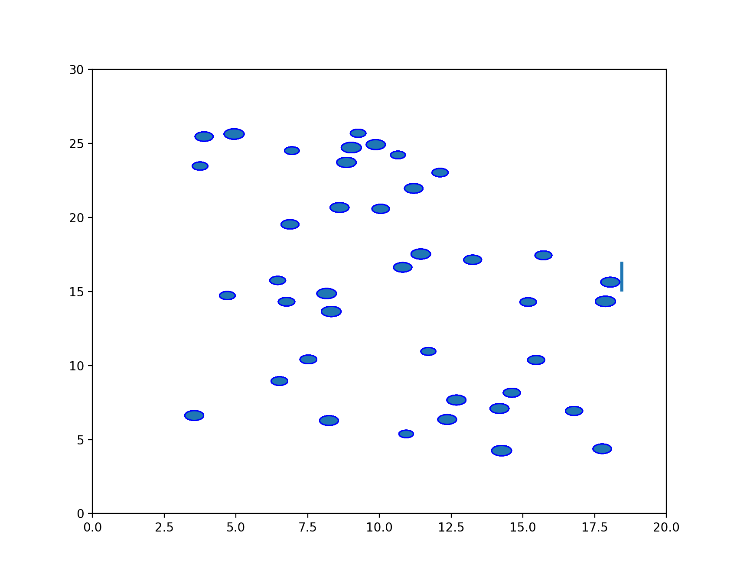
Model: Agent-Based Social-Psychological Model
Room(Environment):
Size is 20m x 30m
Single Exit
Smoky
People(Agents):
Each person is represented by a circle with certain radius. (0.25m to 0.3m)
Other attributes: Vison Range (R_{i}), Velocity (V_{i}) , Desired Direction(e_{i}), Mass(m_{i}), Degree of Panic (P_{i}).

Slide 4
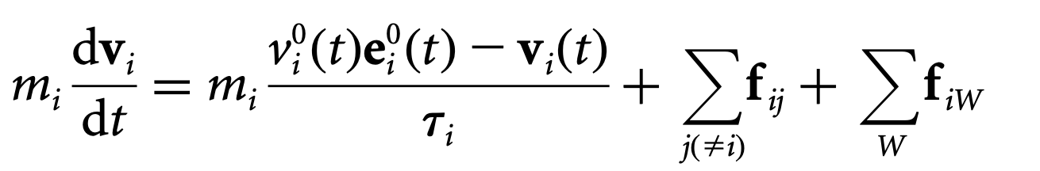
Rules of the ABM
The crowd dynamic simulation is based on a generalized force model (Newton’s second law of motion F=ma) . Dirk et al. [2000]
The first term is the social-psychological force(a virtual force); it describes a pedestrian i’s tendency to move to a desired direction in a desired speed.
The second term is the sum of forces between pedestrians.
The third term is the sum of forces between a person and a wall.
How agents behave on their own
How agents interact with each other
How agents interact with the environment

Slide 5
Physical Force: person j on person i
f_{ij} is the ‘interaction forces’ between pedestrian i and pedestrian j, represented in a basis (n_{ij} ,t_{ij})
Repulsive force in the direction pointing from j to i (n_{ij}) In this model, two individuals can partially overlap
Fraction force in the tangential to n_{ij} (n_{ij} ⊥ t_{ij})
∆vij=(v_{i}-v_{j})∙t_{ij} represents the velocity
difference vector projection on t_{ij}
Vi
Vj
n_{ij}
t_{ij}
j
i

Slide 6
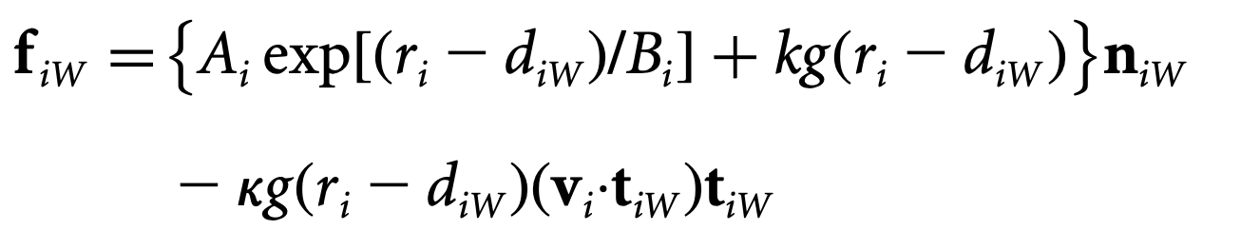
Physical Forces f_{iw}
Analogously ,f_{iW} is the ‘interaction forces’ between person i and the wall, represented in a unit basis (n_{iW} ,t_{iW})
Using the same constants to calculate the repulsive and fraction forces.
We use the constants recommended in Dirk et al. [2000].

Slide 7
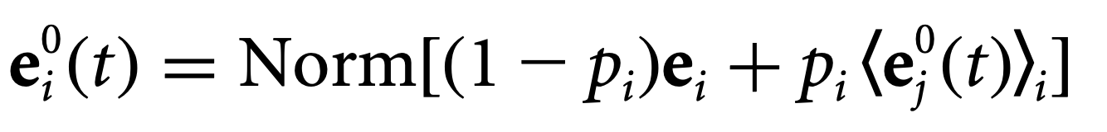
Desire direction
In smoky room, pedestrian has a limited vison range R_{i}
e_{i} represents the desire direction
Initially individuals moving in a random direction
When the exit is in his/her sight (d<R_{i}), e_{i} is pointing to the exit
When other individuals show up in his/her sight (dij<R_{i}), the individual will follow the others average direction (<e_{j}>) with a fraction p_{i}.
p_{i} describes the degree of panic of individual i

Slide 8
Assumptions: herding
In an emergency situation, people often show the so-called collective ‘herding’ behavior, i.e. when undergo panic feelings, people tend to run and follow other running people. This behavior can be implemented
Implementation:
Complete Panic: Set p_{i} to 1

Slide 9
Assumptions: The role of leader
In a smoky room, the vision range of a person is about 3m to 4 m. Thus the first role of leader should be to inform everyone where the exit is.
Very often, when many people want to go through a single exit in an emergency situation, pushing and clogging happens.

Slide 10
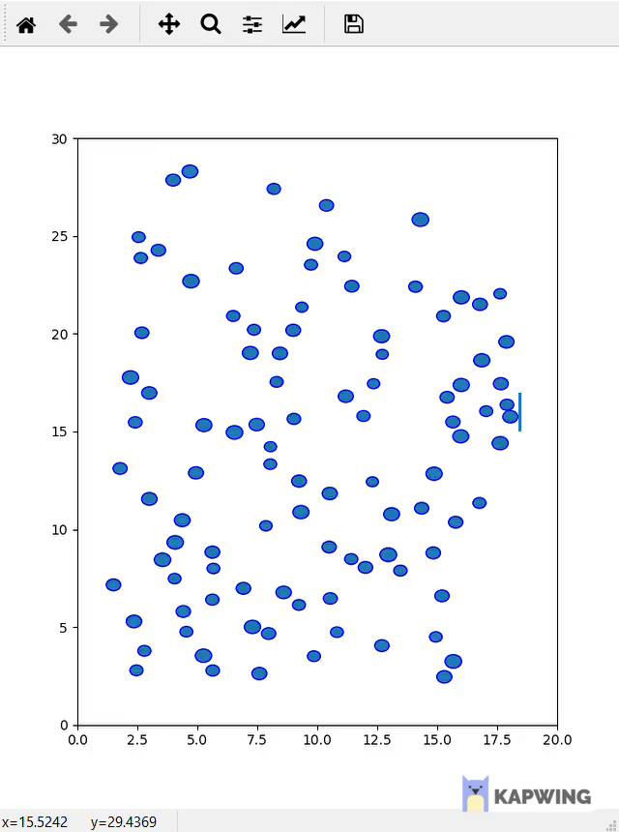
Result: Complete Panic, No leaders

Slide 11
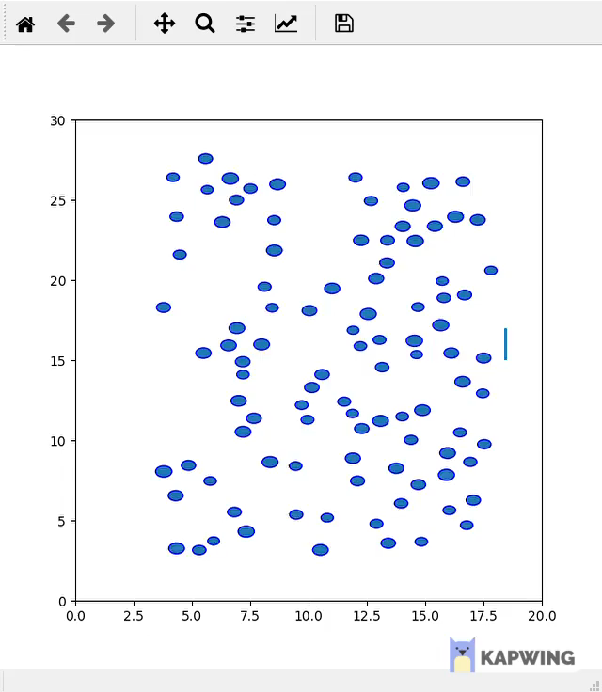
Result: The role of leaders

Slide 12
Future Work
Quantitative comparison of the two scenarios:
With leaders
Without leaders

Slide 13
Questions ?

